Slide 1
Transformers

Slide 2
“ mat”
Aim to understand this box
“The cat sat on the”

Slide 3
Disclaimers
Some details skipped.
All in notebook, either explained directly or in code
Some terminology notes
‘length of vector’ means number of entries of vector. Not length in geometric sense.
‘d’ means ‘dimension’, for example ‘d_model’
No mention of batches. It is not conceptually difficult or interesting
But it does add cognitive load in the code!
No mention of arrays
Arrays are not conceptually the correct object
Arrays package the information for efficient compute
E.g. a 2d-array means three different things in transformers: a list of vectors, a map between vectors, grid of all possible dot products.
Few mathematical formulae
If you’re the kind of person who likes formulae, then optional exercise is to write the formulae.

Slide 4
Understanding logits and softmax via log odds
Odds instead of probabilities
Instead of probabilities 0.8, 0.1, 0.05, 0.05 have odds 16:2:1:1
Gives relative probs via ratios. E.g. 1st option is 8 times more likely than 2nd
Question: how to convert from odds to probabilities?
Log odds instead of odds
Take the log of these odds. Use base 2 for simplicity. 16:2:1:1 becomes 4:1:0:0
Gives relative probs via differences. ‘Add 1’ = ‘2x more likely’. ‘Add 3’ = ‘2^3x more likely’.
Question: how to convert from log odds to probabilities
Big idea 1: when you see logits, treat them as log odds
Big idea 2: softmax converts log odds to normal probabilities
Minor detail: Softmax uses base e instead of base 2. So difference of 3 corresponds to factor of e^3 in probability.

Slide 5
“ mat”
Sampler
Transformer
Transformer
Tokenizer
“The cat sat on the”
Notes:
First black box in split into three pieces. We are going to work our way from the outside inwards.

Slide 6
Tokenizer
Input: string. Output: list of integers.
See notebook for more information
[“180”, “876”, “ 1212”, “195”, “ 215”]
Tokenizer part 1
Tokenizer 2nd half
[“The”, “ cat”, “ sat”, “ on”, “ the”]
Tokenizer part 1
Tokenizer 1st half
“The cat sat on the”
Notes:
stress the lack of time and not able to spend time here. Avoid answering questions beyond understanding what is on the slide. Token ids are made up
Often we are lazy and do not clearly distinguish between token and token id. Not a big deal

Slide 7
Sampler
Input: list of floats. Output: token
List of floats is logits. One logit per token in the vocabulary
Many possibilities. E.g. pick most likely, sample according to probabilities,…
“ mat”
Tokenizer part 1
Sample
[0.018, 0.0002,..., 0.8,..., 0.1,...,]
Tokenizer part 1
Soft max
[-2.1, -4.2,...,1.7,..., -0.3,...,]
Notes:
stress the lack of time and not able to spend time here. Avoid answering questions beyond understanding what is on the slide

Slide 8
“ mat”
Sampler
Transformer
Question:
What do you think is the input and output of the transformer
Transformer
Tokenizer
“The cat sat on the”
Notes:
Say that they should be able to use previous information to answer this. Give enough time for *everyone* to think through previous slides! Don’t just let first person answer for everyone

Slide 9
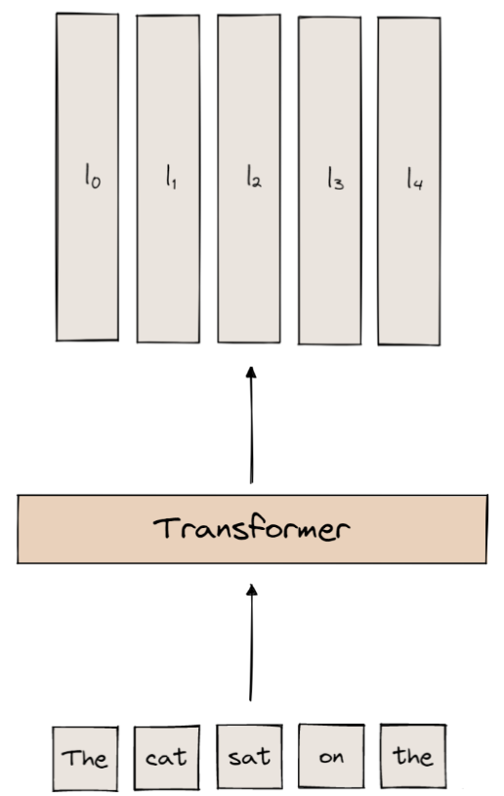
Input: list of tokens / token ids
Output: One set of logits per input token!
E.g. logits for “ on” gives predicted next token for “The cat sat on”
In inference: only final token’s logits are used
In training: all logits used! A single sequence is actually len(sequence) many training points
THIS IS A BIG DEAL!
Notes:
Mention how this is unexpected! Based on previous slides, expect only one set of logits, not many.

Slide 10
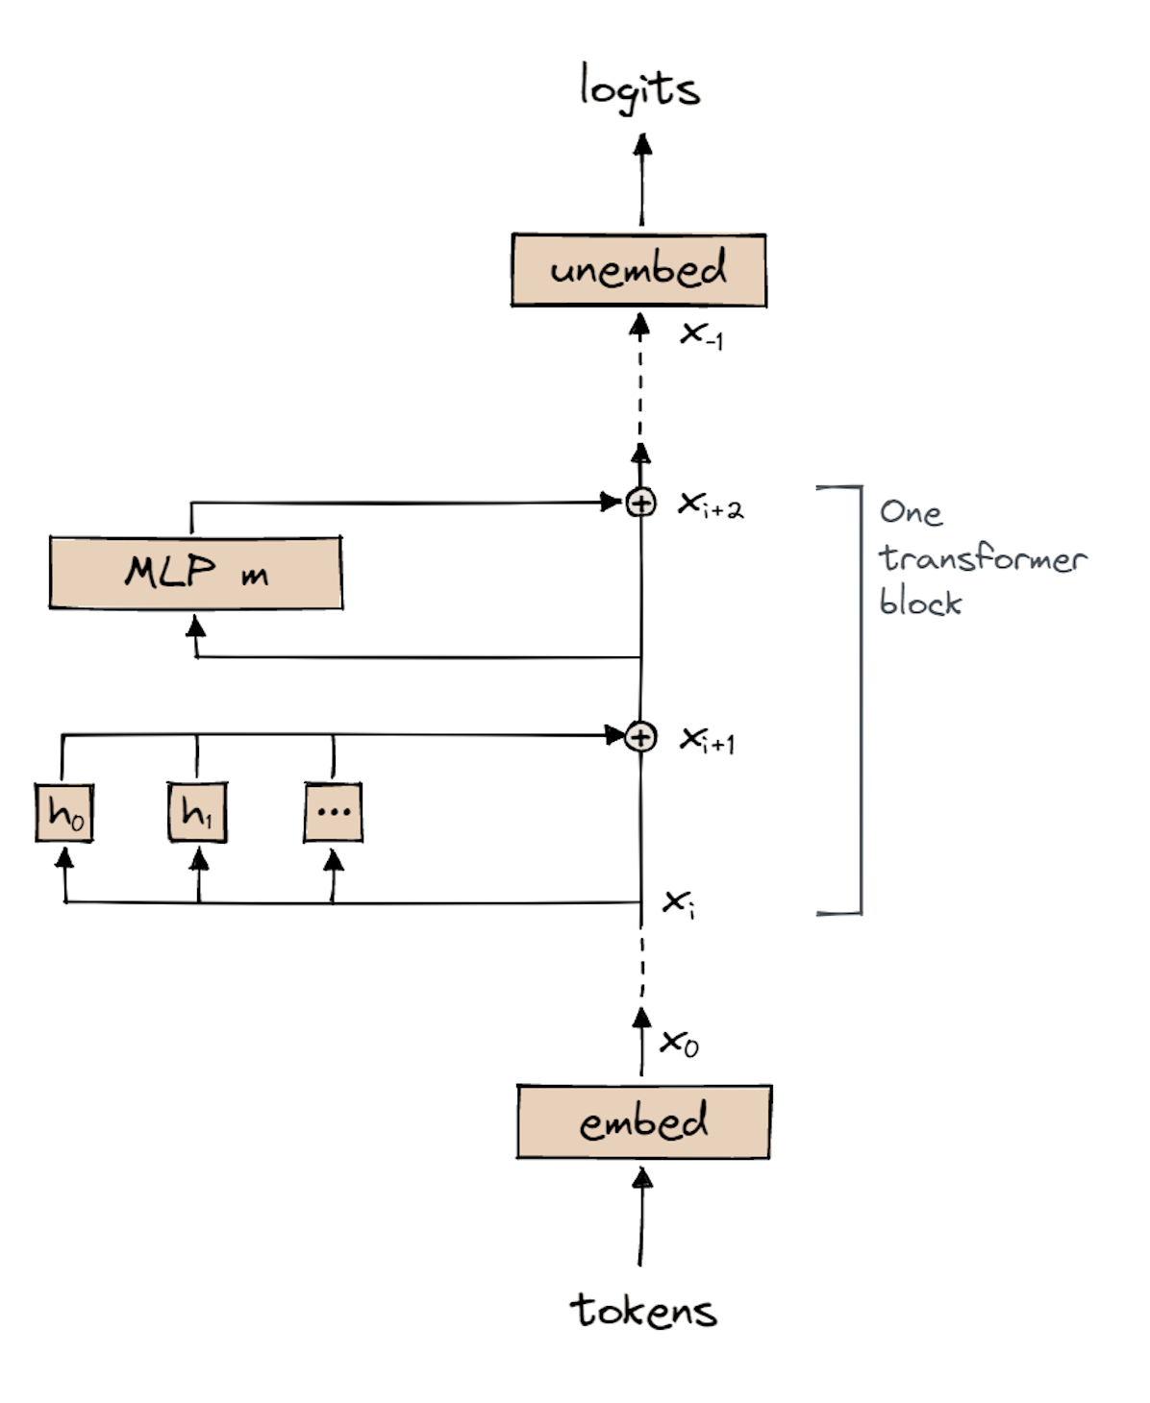
Vertical line of x’s called ‘residual stream’.
x_i is list of vectors, one vector per input token.
Length of vectors is d_model
Have n_layer many transformer blocks
Transformer block = attention layer then MLP layer
Attention: move information between tokens
(also some processing)
MLP: Process information within each token independently

Slide 11
Embedding
Input: list of ints. The token ids
Output: x_0, list of vectors. One vector per input token. Each vector has length d_model
How?
Just a lookup table! Each token is associated with a particular vector
Tokens with similar meanings should have similar vectors
(Omitted detail: Positional embedding)
Notes:
Repeat that we are working from outside in.

Slide 12
Unembed
Despite the name, *not* the opposite of embedding
Input: list of vectors. One vector per input token. Each vector has length d_model
Output: list of logits. One set of logits per token.
How?
W_U, b_u. Weight and bias to get output in desired shape
Important: Same W and b used for each token position.
logits[i] = W_U * x[i] + b_u

Slide 13
Recap:
What is name of vertical line of x’s?
What is length of vectors in the x’s?
How many vectors are there in each x_i?
What is the input for embed?
How does embed turn its input into vectors?
What is the output of unembed?
How does unembed convert vectors to logits?

Slide 14
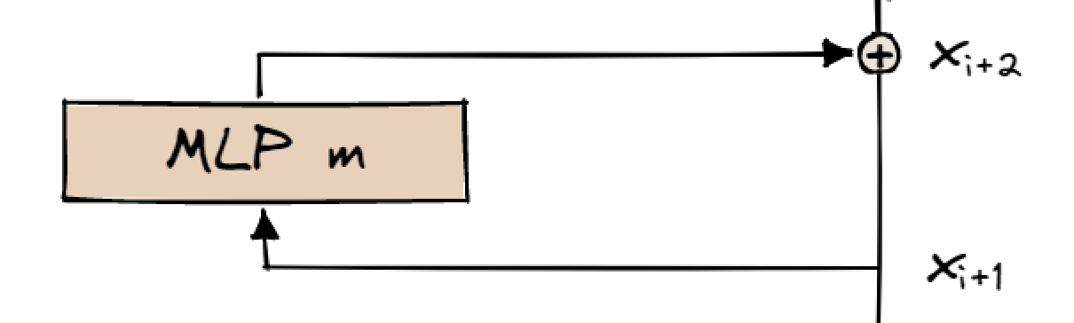

MLP Layer
Input: list of vectors. One vector per input token. Length of vector is d_model
Output: list of vectors. One vector per input token. Length of vector is d_model
x_{i+2} is NOT the output of m
The output of m is added onto the input. Indicated by + symbol.
Known as a ‘residual connection’

Slide 15
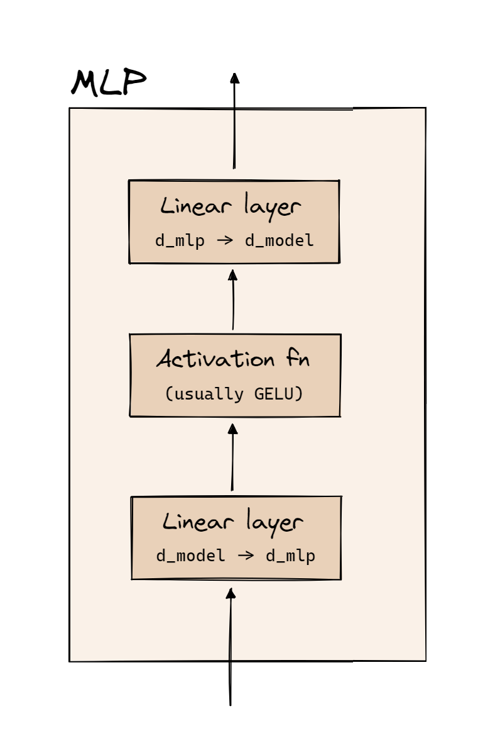
MLP Layer ctd.
Have one vector per input token.
Length of vector changes from d_model to d_mlp then back to d_model
Same as in unembed, tokens are independent throughout these calculations.
(Detail omitted. LayerNorm.)

Slide 16
Recap:
What is name of vertical line of x’s?
What is length of vectors in the x’s?
How many vectors are there in each x_i?
How does embed turn its input into vectors?
How does unembed convert vectors to logits?
What does + symbol in residual stream indicate?
What are the steps inside MLP layer?

Slide 17
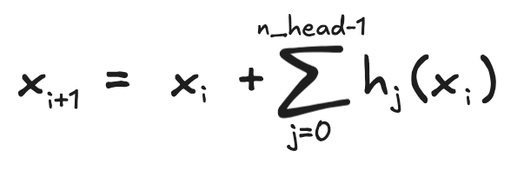
Attention layer
Input: list of vectors. One vector per token. Length of vector is d_model
Output: list of vectors. One vector per token. Length of vector is d_model
Each h_i is an ‘attention head’
Attention heads all independent of each other
All their outputs added to input
Number of heads is n_head
(Detail omitted. LayerNorm)

Slide 18
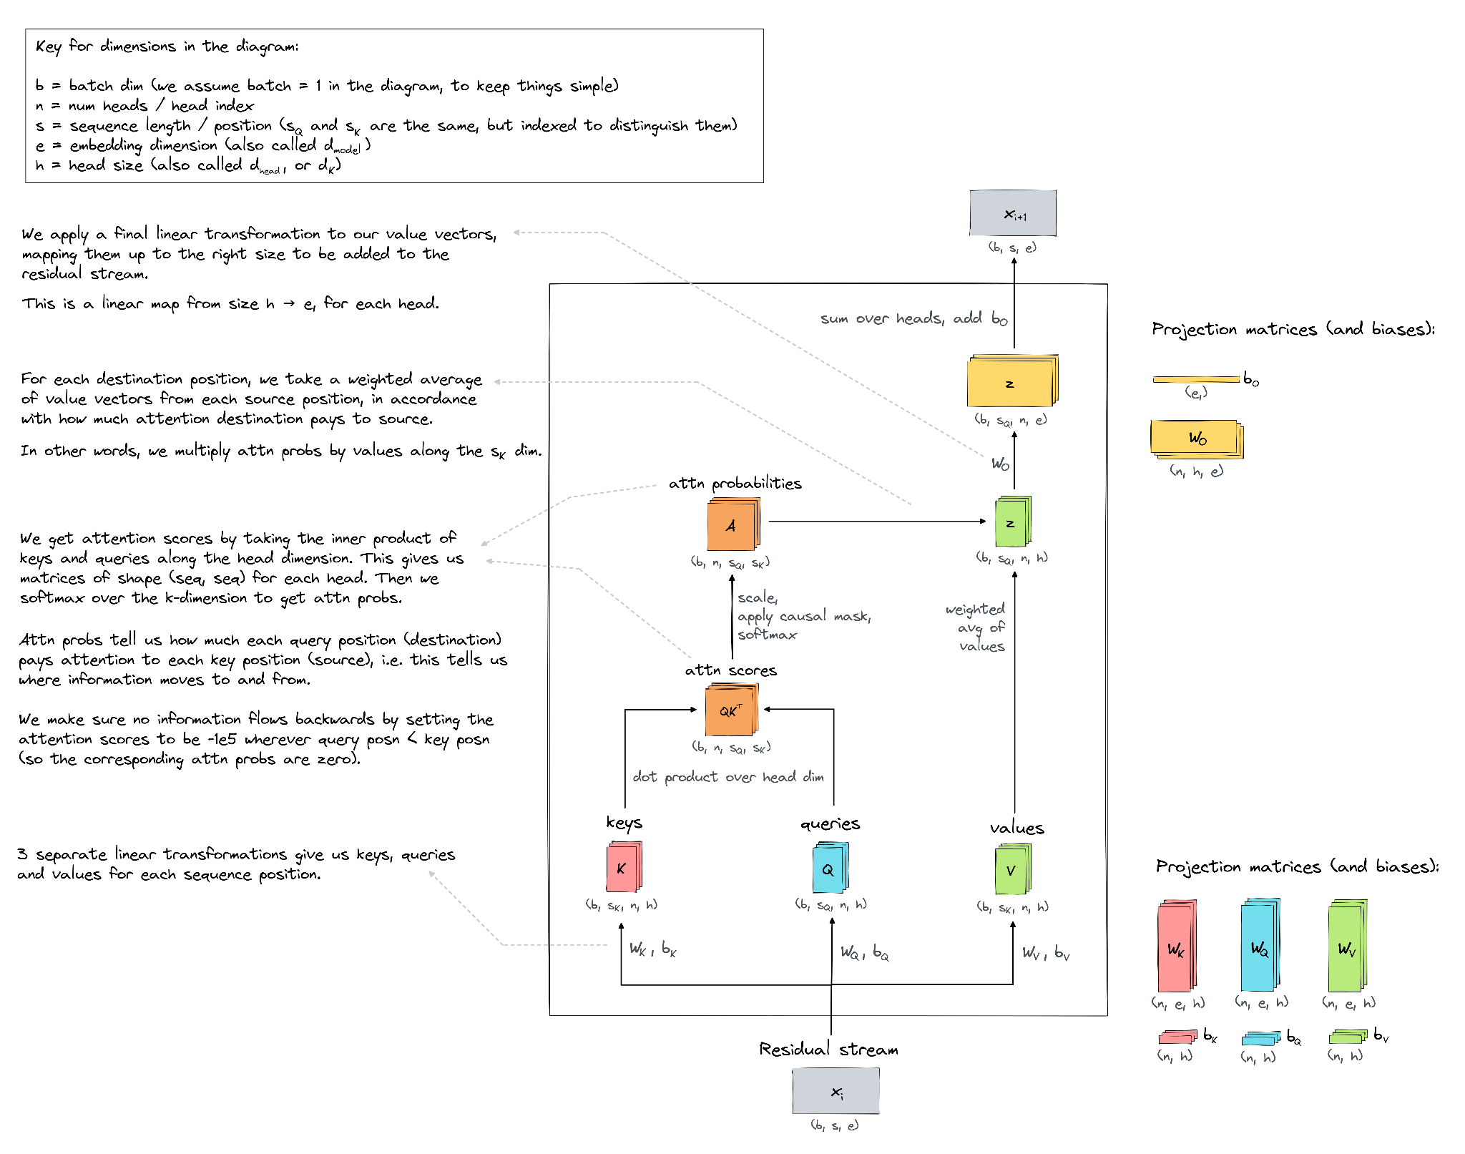
Notes:
Show this. But DO NOT talk through it. Maybe point out things that are not intuitive, e.g. QK^T forces you to think in terms of rows and columns, which is not conceptually interesting. And not needed with einsum!
Source is Arena’s notebook:
https://www.google.com/url?q=https://colab.research.google.com/drive/1z0aMOrdMG-r8jAILOf588y7uWrp6oPPp%23scrollTo%3Do_WZWukYm4R-&sa=D&source=editors&ust=1727601853930991&usg=AOvVaw0s_E1irCyTF_0dGu9uLvcC

Slide 19
Attention layer
Focus on one head. Call it h
The steps inside h are:
Start with one vector per input token. Length is d_model
Create *three* vectors per token.
Length of these are d_head
Called ‘key’, ‘query’ and ‘value’ vectors
Use K[i] to indicate the key vector for token i. Similar for Q and V
Done using weights and biases. W_K, b_K, W_Q, b_Q, W_V, b_V
Do bunch of calculations (in next slides)
Get one vector per token. Called z
Length of these are still d_head
Go back to residual stream.
So one vector per input token, length of these are d_model
Done using weights and biases. W_o, b_o

Slide 20
Attention layer
Focus on one head. Call it h
Focus on output for one token position, say token position 3.
The final d_head vector for this token:
Z[3] = A[3,0] V[0] + A[3,1] V[1] + A[3,2] V[2] + A[3,3] V[3]
It is weighted-sum of previous tokens’ value vectors
A[3,0] is how much attention token 3 puts on token 0
A[3,0] + … + A[3,3] = 1, and these A’s are all positive
So a probability distribution. What function creates these…
Question. How would this look for a generic token i, not token 3?
Mottos:
Values are information sent from one token to another
A[i,j] is how much ‘attention’ token i is paying to token j

Slide 21
Attention layer
Focus on one head. Call it h
Recap the steps so far inside h:
Key fact: each token gets *three* vectors, not just one. Can deduce a lot of structure from this.
Key fact: the mottos. What were they?
What are the three vectors called?
How do we get from the d_model vector to these three vectors?
How do we get back to d_model?
For the 5th token, what does z vector look like?

Slide 22
Only thing left is calculating A. And we haven’t used K or Q yet…
Key idea: Q[3] dot product K[0] is logit of A[3,0]
Calculate all dot products. Get square grid
‘Causal mask’. Ensure tokens do not pay attention to future tokens
(Detail. Scale by dividing by root(d_head).)
Apply softmax, to get probabilities
Warning: easy to get this wrong. Is it applied to each row or col?
Solution: use einops! No longer think in terms of rows and cols.
Mottos
Query is question that token wants answer to.
Key is question that token has the answer to.
So if Q[3] dot K[0] is large, then 0th token can answer the question 3rd token is asking
And then 0th token passes V[0], ‘the answer’, to 3rd token.

Slide 23
Attention layer
Focus on one head. Call it h
Recap inside h:
What is first step for h?
What is motto for values?
What is motto for A?
What is motto for keys?
What is motto for queries?
Key idea for calculating A[i,j] is…?
Z[3] equals what? (In terms of A and V)
How do we get from the grid of dot products to A[i,j]?
How do we get from z to d_model vectors?
Detail: We have separate W_o for each head, but only one b_o

Slide 24
Notes:
Task:

